Slide 1

Orion
Analytics
A data analytics start-up trying to make the world a better place, one solution at a time.

Slide 2

THE COMPANY
Founded by three ambitious python developers : Daisy, Harini and Satish of St. Joseph’s college (Autonomous), Bengaluru, on a cold, rainy day in June 2019.
What started out as a quest to get marks for a project turned into an idea for a start-up that is ‘Orion Analytics’.
We chose the name Orion because it’s a constellation and the Orion’s belt has 3 stars, all in a row, displaying no hierarchy, much like our small team of 3 people.
We work on multiple domains and solve problems related to data analysis.

Slide 3

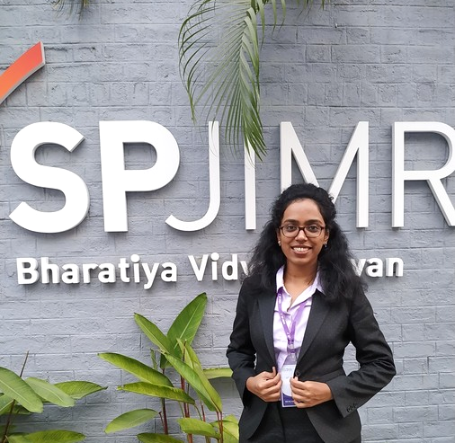

✋ Meet the team! ✋
Hello! I am Daisy. I love art. I would rather be art-ing right now. But I guess data analysis is also a kind of art?
Hello! I am Harini. I am here because I love presentations. No, I am not joking. Amy from B99 is my spirit animal.
Hello! I am Satish. I like biking through mountains.

Slide 4



OUR SERVICES
Marketing analytics
Applying analytics to enhance the impact of your marketing expenditure
Customer Analytics
Analyze and understand your customers for better engagement and returns
Custom solutions
Plan and optimize your investment in business operations
Analytics in Healthcare
Enable better patient access through more efficient care delivery with the right staffing and skills.
Risk Analytics
Drive your business into profit with intelligent risk analytics and improve your company’s security.
Social Media Analytics
We help you optimize your social media presence and make the most out of it.

Slide 5

ILLUMINATE
Orion Analytics
presents
No more unanswered questions!

Slide 6

Often in group chats many texts get ignored due to high inflow of texts.
As a result, important questions go unnoticed and hence unanswered.
This is a crucial problem especially when it comes to webinars and online classes/lectures. The lecturer is unable to spot the question from the ocean of unrelated texts and the student often loses.
Real life scenario
We wanted to solve this problem and thus was invented the add-on : Illuminate
The Problem

Slide 7

OUR SOLUTION
Install illuminate add-on
To enjoy the service, both parties must have illuminate installed in their respective devices
Start typing
Illuminate is constantly running in the background. So you don’t have to launch anything new.
Enjoy the attention!
Have fun getting your questions answered. And don’t worry, we do not collect any of your personal data!

Slide 8
HOW DOES IT WORK?
Illuminate is an add-on that can be installed over any application or web page that deals with a lot of text data.
Illuminate helps in highlighting questions from the ocean of texts that are exchanged, enabling the lecturer/concerned person to give quicker responses and thus preventing them from getting ignored
It does this by running a Keras based sequential model using NLP in the background and classifying the texts as either question or not a question

Slide 9
THE STORY SO FAR AND THE FUTURE
The model perfectly classifies a text as a question or not a question accurately over 85% of the time
With funding, we will be able to allocate resources to scaling the model to a larger extent and in real time classification of texts as and when they are sent.
This add-on will be very useful especially for websites that offer online webinars and live coaching classes.

Slide 10
“You shall know the nature of a word by the company it keeps.” – John Rupert Firth

Slide 11
OUR PRODUCT
Our add-on also does word-prediction similar to Google’s ‘Smart compose’ concept in Gmail - it suggests the next word you should type based on your text corpora
It does this by using a probabilistic model called N-grams.
It makes your typing faster and effective
With funding, we can increase the text corpora on which the model was trained and as data accumulates, we will be able to do it in real time

Slide 12




STRENGTHS
WEAKNESSES
Easy to use
No additional software required
Does not store private data
Will be hard to build a reputation
Lack of capital and low computational resources
Does not work on real time data yet
S
W
O
T
OPPORTUNITIES
THREATS
Collaborate with websites like Edureka, Byju’s
Chatbots in customer care
Being unprepared for a large number of people
Big companies like Gmail already use Smart compose concept

Slide 13
DEMO – How the app works

Slide 14
If you have any questions or suggestions, do leave them in the comment section below.
THANKS FOR WATCHING

